Slide 1
When Coding Style Survives Compilation: De-anonymizing Programmers from Executable Binaries
Aylin Caliskan, Fabian Yamaguchi, Edwin Dauber, Richard Harang, Konrad Rieck, Rachel Greenstadt and Arvind Narayanan
Princeton University, Drexel University, Shiftleft Inc., Sophos, TU Braunswcheig

Slide 2
What’s the paper about?
Problem
De-anonymizing has implications for privacy and anonymity
It’s possible to attribute a source code to an author with high accuracy, what about an executable binary?
Previous work (Rosenblum et al.) achieved average accuracy
Contribution
De-anonymizing executable binary even with aggressive compiler options, debugging symbols removed, obfuscation
Results
With 100 candidates, attributed authorship with 96% accuracy
With 600 candidates, attributed authorship with 83% accuracy

Slide 3
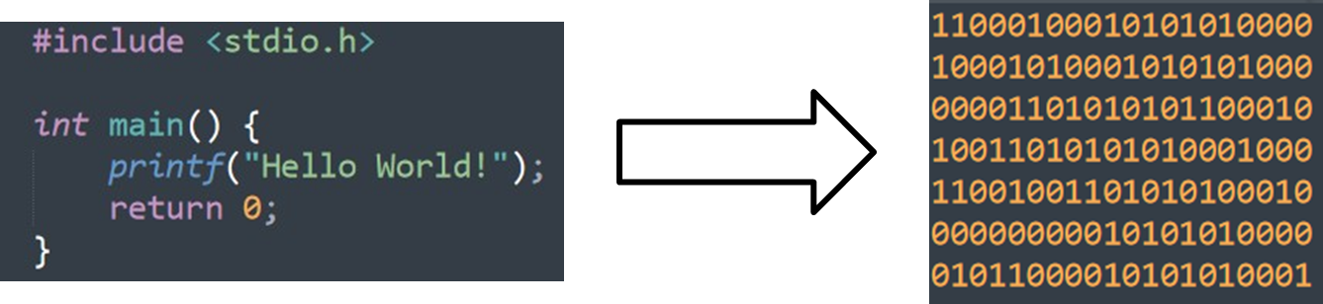
Introduction
What is an executable binary?
What happens when you compile your source code?
Generate machine code which is cryptic

Slide 4
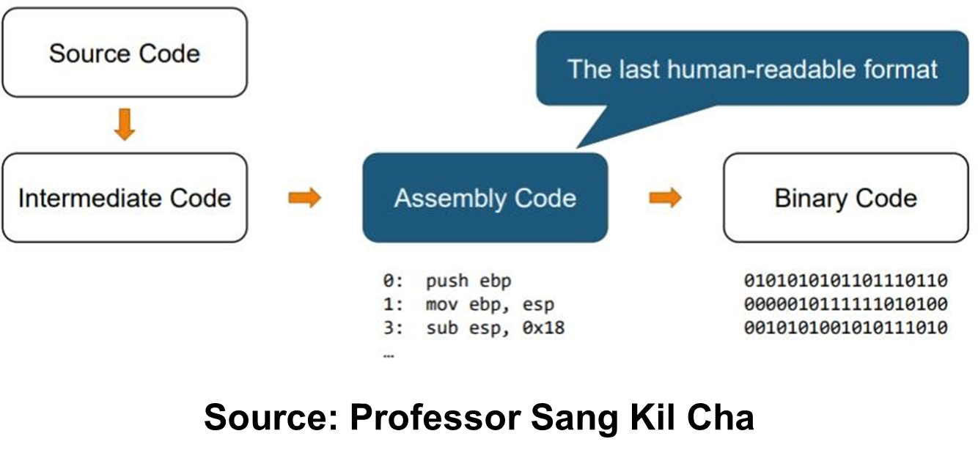
Introduction

Slide 5
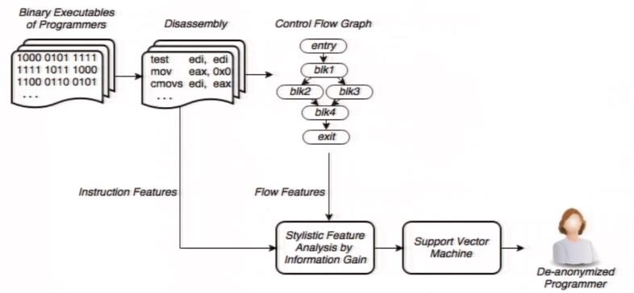
Previous work (Rosenblum et al.)

Slide 6
Previous work (Rosenblum et al.)
Rosenblum vs Aylin Caliskan
Coding style features: 1900 vs 53
Training samples: 8-16 vs 8
Best accuracy using SVM: 51% vs 71%

Slide 7
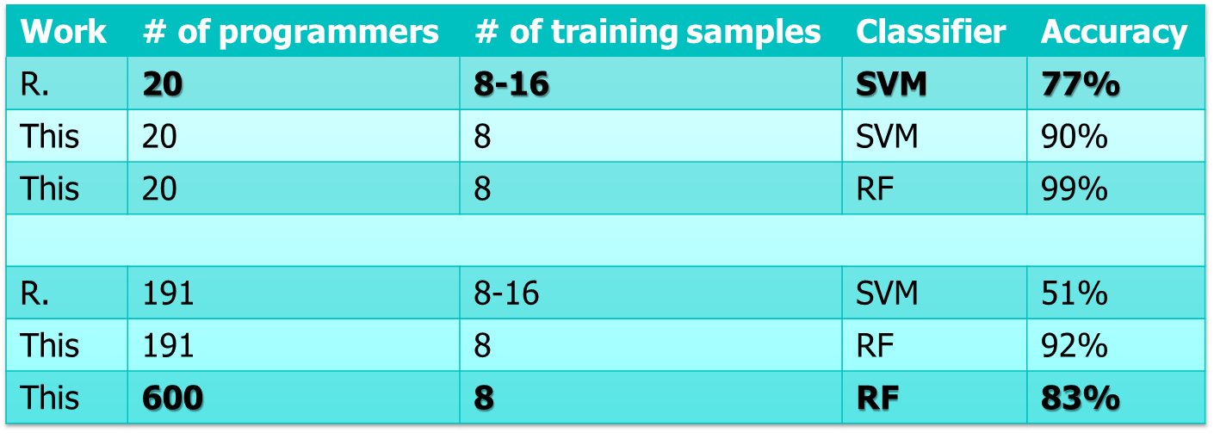
Comparison

Slide 8
Background
The goal is to automatically recognize programmers of compiled code
Using supervised machine learning
Generate a classifier from training data
Easily retargetable to any set of data
Might not work if the dataset is too short or unavailable
Using low-level features from disassemblers and high-level features from decompilers

Slide 9
Dataset
1000 submissions from Google Code Jam
Only 600 were compiling
Compare the results with Rosenblum’s work
439 repositories from 161 authors on GitHub
C/C++ source code
Popular repository (presence of 5 stars)
Only one author committed to the repository
At least 200 lines of code
Not a fork of another repository
Leaked Nulled.io forum
4 forum members
13 Windows executables

Slide 10
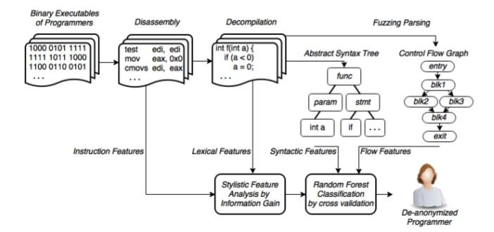
Procedure by the author

Slide 11
Procedure by the author
Instructions, symbols and string are extracted using disassemblers
Abstract syntax tree and control-flow features are obtained from decompilers
Dimensionality reduction with information gain criteria and correlation analysis
De-anonymize the programmer

Slide 12
Disassembly
A disassembler transforms machine code into a human- readable mnemonic representation called assembly language
Disassemble the executable binary to extract low-level features
Two disassemblers
Netwide disassembler (ndisasm)
Radare2
Why 2 disassemblers?
Netwide disassembler does simple instruction decoding
Radare2 extracts symbols, strings, functions and control-flow graphs

Slide 13
Netwide Disassembler (ndisasm)
Used for simple instruction decoding
Doesn’t have any understanding of object file formats
No distinction between data bytes and code bytes
Inaccuracies doesn’t degrade the classifier (?)

Slide 14
Radare2 disassembler
State-of-the-art open-source disassembler
Based on Capstone disassembly framework
Multi-platform
Multi-architecture (ARM, ARM64, MIPS, X86, X86_64, etc)
Figures out the executable binary format
Extracts symbols from dynamic and static symbols table
Extracts strings
Generates control-flow graphs
Gains knowledge over functions of dynamic libraries

Slide 15
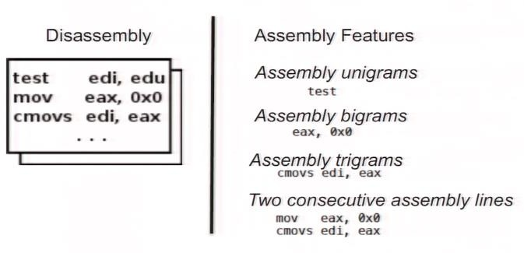
Disassembly

Slide 16
Decompilation
A decompiler reverts the process of compilation and outputs the same program in a higher-level constructs
Using Hex-Rays decompiler
Produces human readable C-like pseudo-code
Code might be longer than the original source code
70 lines of source code with Hex-Rays produces 900 lines of decompiled code
Extract lexical features and syntactical features

Slide 17
Decompilation: What is an AST?
Abstract Syntax Tree
Tree representation of the abstract syntactic structure of a source code
Each node denotes a construct occuring in the code
Abstract because doesn’t represent every detail appearing in the real syntax

Slide 18
Decompilation: What is a CFG?
Control-flow graph
Representation using graph, of all paths that might be traversed through a program during its execution
Each node is a basic block
Directed edges are used to represent jumps in the control- flow

Slide 19
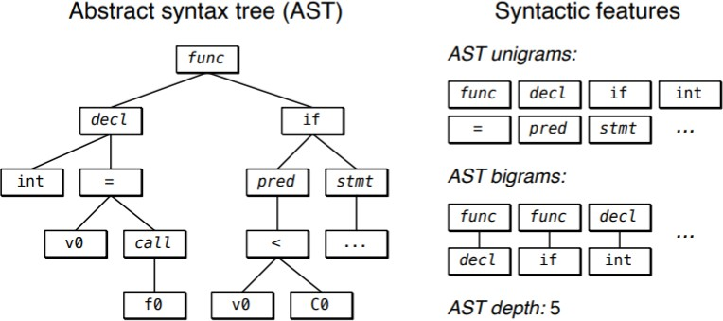
Decompilation

Slide 20
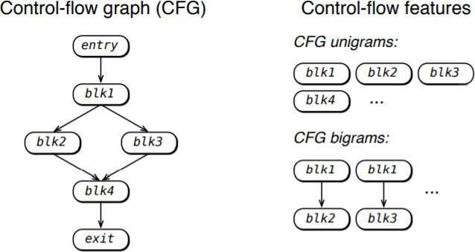
Decompilation

Slide 21
Decompilation: Lexical features
Lexical features are extracted using the pseudo-code
Word unigrams (integer types, library function names, internal function names)
N-gram example: « I read a paper »
Unigram: « I », « read », « a », « paper »
Bigram: « I read », « read a », « a paper »
Trigram: « I read a », « read a paper »

Slide 22
Decompilation: Syntactical features
Syntactical features using joern fuzzy parser
A fuzzy parser is a form of syntax analyzer that performs analysis on selected portions of its input
Pass code to joern to obtain AST
AST node unigrams, labeled AST edges, AST node term frequency inverse document frequency and AST node average depth

Slide 23
Features
Represent coding style preserved in executable binaries
With disassembly and decompilation, extracted 705000 features of 100 authors
Only a small subset really represent individual coding style
Apply information gain criteria
Correlation based feature selection during cross-validation

Slide 24
Dimensionality reduction
Produces 705 000 features
Sparse feature vectors with thousands of elements
Consider a d dimensional vector u, u = (u₁,…,u_{d})
The vector will have a lot of u_{i} = 0
Don’t want this for the random forest’s random subsampling
Not all features are relevant to express coding style
Reducing the dimension to avoid overfitting
Use two methods
Information gain criteria
Correlation based feature selection

Slide 25
Dimensionality reduction
Reduce vector size and sparsity and increase accuracy and model training speed
Information gain criteria
Reduce dimension from 705000 to 2000
Keep features with low entropy
Correlation based feature selection
Reduce dimension from 2000 to 53
No sparsity remaining in the feature vectors
Keep features with low inter-class correlation
53 features kept to reach 96% accuracy for classifying 100 programmers

Slide 26
Classification
Random Forest Classifier
Collection of 500 decision trees
Each tree trained on a subsample of the data
Features are subsampled
9-fold cross-validation 10 times
Increasing the number of features that can be chosen between at each split increases accuracy (using OOB)
OOB (out-of-bag estimate) measures prediction error of random forests
Out-of-bag estimate is as accurate as using a test set
Out-of-bag estimate removes the need for a set aside test set

Slide 27
Classification
Each test example is classified via each of the decision trees
Each of the decision tree vote for a certain programmer
The majority vote defines the de-anonymized programmer

Slide 28
Evaluation
Use programs from Google Code Jam
Compare this work to previous work
Clean and less noisy dataset
Solo competition
Few to no third party libraries
C++ compiled code
2008 to 2014 solutions
Authors and problem identifiers
Assuming that the authors are not trying to be anonymous

Slide 29
Evaluation
Compiling source code with gcc / g++
Training set needs to use the same compiler and options
If not, will detect the compiler rather than the programmer
Measuring the effect of compiler optimizations
Compiled the source code with level-1, level-2 and level-3 optimizations
Optimization flag will optimize: execution time, code size, memory usage, compile time
Might complicate program debugging

Slide 30
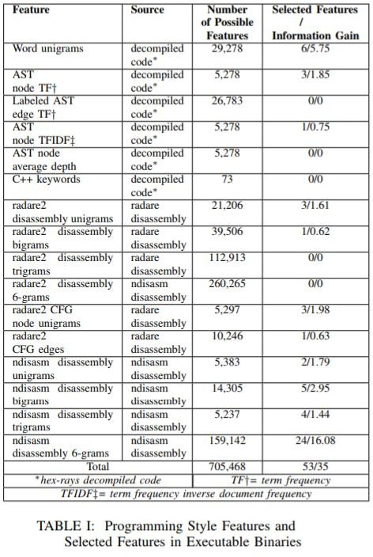
Evaluation
Features that represent coding style
Applied information gain criteria and correlation based feature selection during cross-validation
High accuracy meaning those features provide strong representation of coding style
Used those features on different set of programmers to confirm it

Slide 31
Evaluation
Preprocessing the dataset to generate binaries
Disassemble the binaries
Decompile source code
Extract all possible features and narrow them down to 53
Take a set of 100 programmers each with 9 binaries
Random Forest correctly classifies 900 test instances with 95% accuracy

Slide 32
Evaluation
The model needs labeled examples to be built
The more data you provide, the better the accuracy
Obtaining ground truth might be challenging
Is this method really useful ?

Slide 33
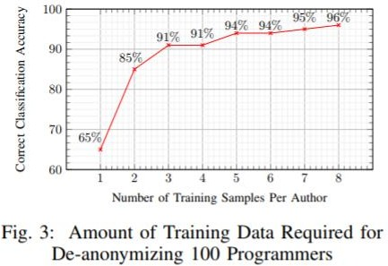
Evaluation

Slide 34
Evaluation
What if there are too many classes or the accuracy is low?
Relax the classification to top-n classification
n is the number of classes
If the test instance belongs to one of the n classes, then classification is correct
Instead of finding one particular author, you just narrow down to a small suspect set

Slide 35
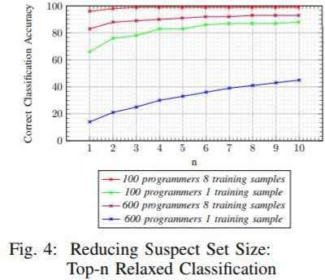
Evaluation

Slide 36
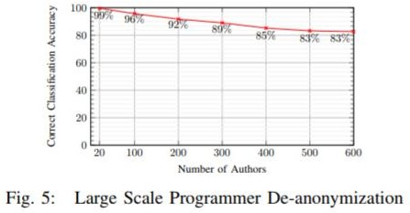
Evaluation
De-anonymizing with a large dataset
Still better than Rosenblum’s best accuracy (51%)

Slide 37
So far..
De-anonymize programmers with high accuracy from binaries
How stylistic features are preserved after compilation?
Correlation of stylistic source code and decompiled source code
Take features from previous work from de-anonymizing programmers from source code
Set one of the 150 features as class for each executable binary
Predict the value through Random Forest with 500 trees
Calculate the Pearson’s correlation coefficient between predicted and original value

Slide 38
Pearson’s correlation
Measures the strength of the relationship between two variables
Can range from -1 to 1
Correlation coefficient < 1: both variables move in opposite direction
0 indicates no linear relationship
Correlation coefficient > 1: both variables are correlated or move in the same direction
Mean of 0.32 and ranges from -0.12 to 0.69 for 150 features

Slide 39
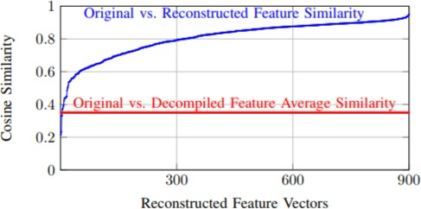
Cosine similarity

Slide 40
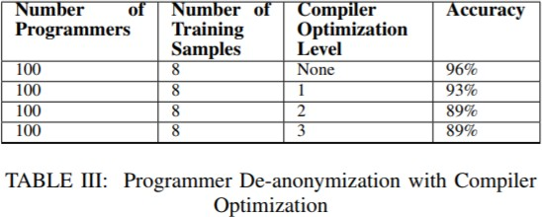
Real-world environment
So far, only clean datasets
Can they deal with more sophisticated binaries?
Optimization during compilation
Minimize or maximize some attributes (execution time, amount of memory used)
Transform program to use fewer resources

Slide 41
Real-world environment
Compiled binaries contain debug information
Fully stripped binary file doesn’t contain debugging symbol
The author fully strips every samples with GNU strips
Without optimizations, classification accuracy drops by 24%
Has an impact but is not effective to anonymize

Slide 42
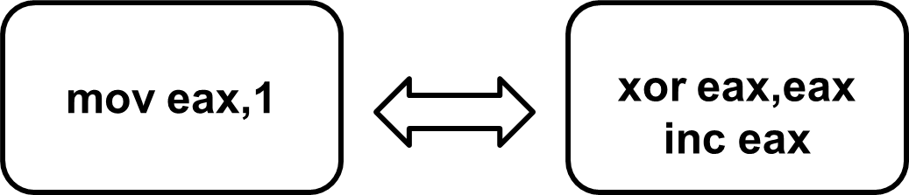
Real-world environment
LLVM to obfuscate the binaries
Substitute instructions by other semantically equivalent instructions
Introduce bogus control-flow, can flatten control-flow graphs

Slide 43
Real-world environment
Using the same features, they train a classifier with the obfuscated binaries from Google Code Jam
Train a classifier on obfuscated samples
Using the same features (53), they obtain 88% accuracy in classifying authors

Slide 44
GitHub experiment
Programming style is preserved to some extent
Test on a new dataset: GitHub
Popular repos (5*)
C/C++ with at least 200 lines of code and not a fork
439 repos from 161 authors
Files are kept only if:
Single author
Author has written at least 10 files (?)
Author has 5 commits
Ground truth is manually verified
2 to 344 files and 2 to 8 repositories for each author
3438 files

Slide 45
GitHub experiment
Compile the projects to get object files (?)
Some projects were not compiling
Target environment not compatible
Files needed to setup environment are unavailable
1075 object files from 90 authors
2 to 24 files per author
Most authors have at least 9 samples
50 authors with 6 to 15 files to perform experiment

Slide 46
GitHub experiment
More difficult to attribute authorship:
GitHub datasets are not as clean as GCJ datasets
3rd party libraries
3rd party code
Not much training data
65% accuracy in correctly classifying programmers

Slide 47
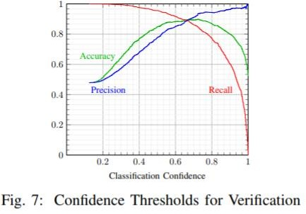
Challenges
In the wild, maybe they never encountered code samples from a programmer in the test set
Change method to check if the file belongs to a programmer in the training set

Slide 48
Nulled.IO hacker forum
Forum dump leaked
Private messages of 585897 members
Share, sell, buy stolen credentials, cracking software
A lot of active developers selling or sharing their code
Declared authorship inside private messages
Software hosted on sharing sites, with active link

Slide 49
Nulled.IO hacker forum
Dataset from 4 members
13 Windows executables
1 member with only one sample
Doesn’t contain native code but bytecode for Microsoft CLI
Can’t analyze it with disassembler and decompiler
Convert bytecode into native code with ngen.exe

Slide 50
Nulled.IO hacker forum
Radare2 couldn’t disassemble so a lot of information is missing
605 features extracted from decompiled source code
features and netwide disassembler features
100% accuracy even with the sample

Slide 51
Conclusion
Experimental results show that this work outperform every other work in term of classification accuracy
This work has limitations
Single author binaries
Only C/C++
No way to tell if code was copied
Tips from the author
Do not own any public repositories
Don’t release multiple binaries using same identity
Use different optimizations and obfuscations to avoid patterns
Try to change coding style or even programming language

Slide 52
Questions

